Slide 1
GROUP MEH Direct Marketing Campaigns of a Portuguese Banking Institution
[Moro et al., 2014] S. Moro, P. Cortez and P. Rita. A Data-Driven Approach to Predict the Success of Bank Telemarketing. Decision Support Systems, Elsevier, 62:22-31, June 2014
Data is provided by the Center for Machine Learning and Intelligent Systems of Bren School of Information and Computer Science at University of California, Irvine.

Slide 2
FEATURE LIST & DESCRIPTIONS
Output Variable:
y: has the client subscribed a term deposit? (binary: 'yes','no’)
Input Variables:
Bank client data:
age: (numeric)
job: type of job (categorical: 'admin.','blue-collar’, 'entrepreneur', 'housemaid','management','retired’, 'self-employed','services','student','technician’, 'unemployed','unknown')
marital : marital status (categorical: 'divorced','married','single','unknown’; note: 'divorced' means divorced or widowed)
education: (categorical: ‘unknown’, ‘secondary’, ‘primary’,’tertiary’)
default: has credit in default? (categorical: 'no','yes')
balance: average yearly balance, in euros (numeric)
housing: has housing loan? (categorical: 'no','yes')
loan: has personal loan? (categorical: 'no','yes')
Related with the last contact of the current campaign:
contact: contact communication type (categorical: 'cellular','telephone’,’unknown’)
month: last contact month of year (categorical: 'jan', 'feb', 'mar', ..., 'nov', 'dec')
day: last contact day of the month (numeric)
duration: last contact duration, in seconds (numeric)
Other attributes:
campaign: number of contacts performed during this campaign and for this client (numeric, includes last contact)
pdays: number of days that passed by after the client was last contacted from a previous campaign (numeric, -1 means client was not previously contacted)
previous: number of contacts performed before this campaign and for this client (numeric)
poutcome: outcome of the previous marketing campaign (categorical:’unknown’,'failure’, 'nonexistent','success’)
Created attributes:
month_num: last contact month of year (numeric: 1,2,…,11,12)

Slide 3
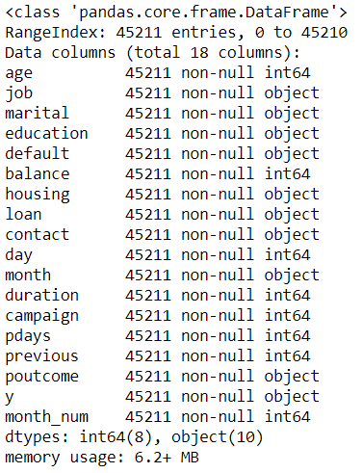
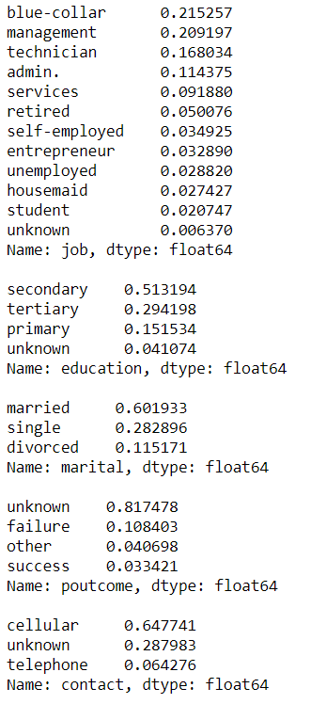
DATA EXPLORATION: NAs
Data summary is as follows. There seem to be no NA values in the dataset; however, there exist NA values named as “unknown”.
“unknown” values are observed in terms of their proportions. Even if the rate of a proportion is high as shown with a red square, we will not exclude the corresponding variable at the first step. We will consider it after evaluating all the variables.

Slide 4
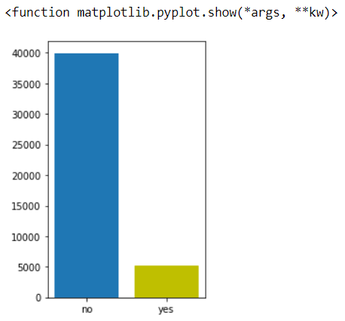

IMBALANCED DATA
Data is imbalanced since “no” answers are approximately six-fold of “yes” answers.

Slide 5
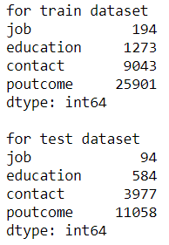
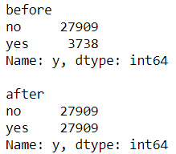
DATA PREPARATION
Before further exploration, we will handle NA values, balance the data, and split the dataset into two parts which are train and test.
Data is randomly divided into two parts: train (70% of data) and test (30% of data)
“unknown” values are converted into NaNs, and they are replaced with the most repeated value. This process is done for train dataset and test dataset distinctively. The number of replaced NA values can be seen in the table on the left.
Train dataset is balanced with the oversampling method. You may see the states before and after implementation.

Slide 6
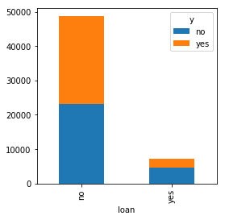
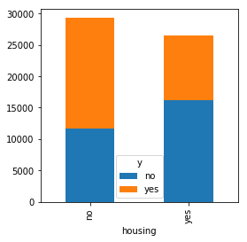

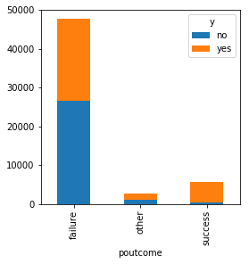
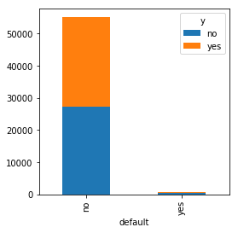
DATA EXPLORATION: CATEGORICALS
There are 8 numeric variables and 9 categorical variables.
Exploration of categorical variables:
A customer having a loan tends to say “no” as a response.
A customer having a house tends to say “no” as a response; also, having no house triggers customers to say “yes”.
Success of a previous campaign leads customers to say “yes” again.
Default has got remarkably low “yes answers.

Slide 7
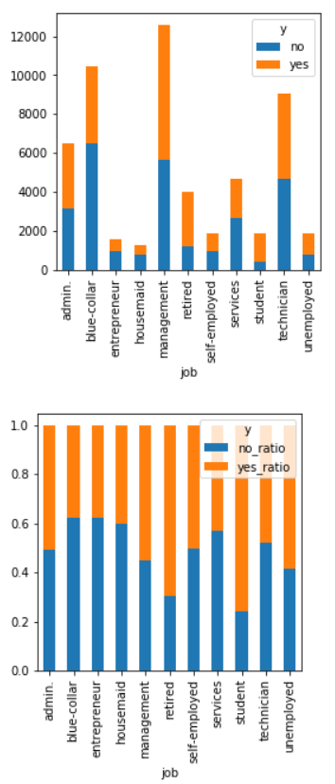
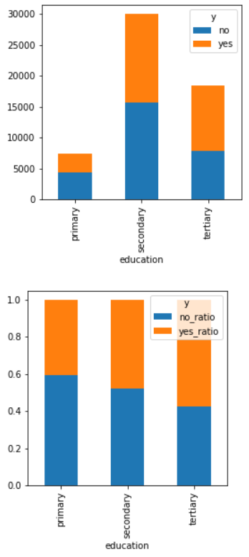
DATA EXPLORATION: CATEGORICALS
Exploration of categorical variables:
The number of observation for each category varies.
Different ratio of “yes” responses for a different type of jobs (Example: The highest proportion of “yes” is observed in the student group)
The higher education level, the higher the ratio of “yes” responses as shown in related figure on the lower right.

Slide 8
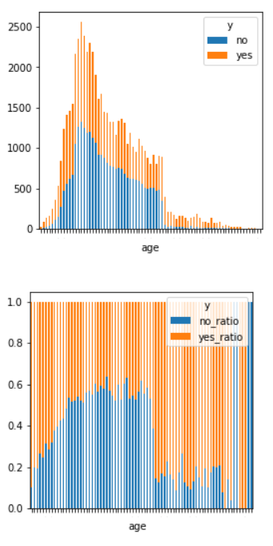
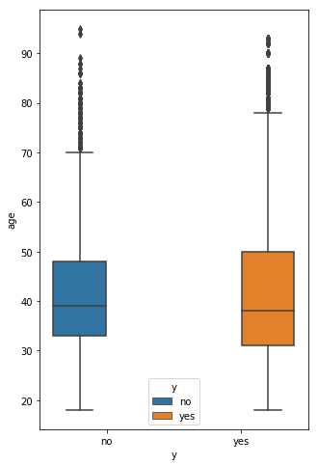
DATA EXPLORATION: NUMERICS
Exploration of numeric variables:
As age increases, the frequency of observations decreases after a specific point
Second stacked bar plot illustrates normalized values of frequencies. It implies that younger people may tend to say yes more.
Boxplot indicates no significant age difference between people who says «yes» and «no»

Slide 9
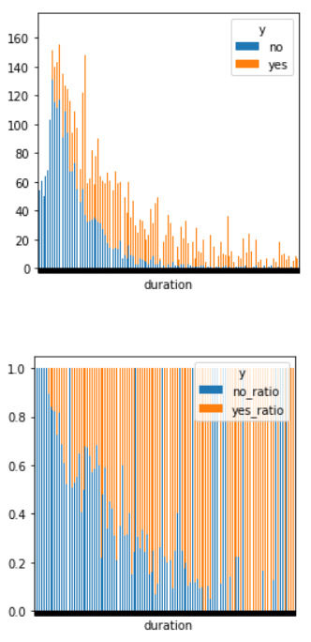
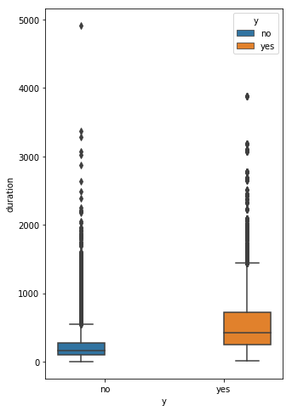
DATA EXPLORATION: NUMERICS
Exploration of numeric variables:
Number of observation decreases as duration increases
The normalized plot shows that the ratio of «no» responses generally decreases as duration goes high
Boxplot indicates that «no» response is observed with less duration

Slide 10
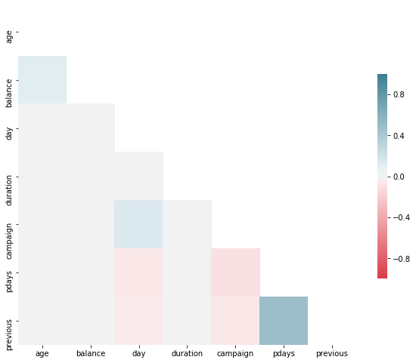
DATA EXPLORATION: HEATMAP
Heatmap shows the correlations between numeric variables.
Variables of “previous” and “pdays” seem to have a positive strong correlation. This is a part that we should be careful about.
Other correlations can be ignored for now since they are represented with grey or light colors.

Slide 11
METHODOLOGY
DATA PREPARATION I
Train/Test Split
Oversampling
Visualization
Missing Values
DATA PREPARATION II
Feture Extraction
Feature Importance with Random Forest
CROSS-VALIDATION & PARAMETER TUNING
Random Forest:
n_estimators
criterion
min_samples_split
Logistic Regression:
Link function
Decision Tree:
criterion
splitter
min_samples_split
TEST
AUC
Accuracy
Precision
MODELS

